Slide 1
Software Quality Engineering
Lecture 3
Part II-software testing
Structural testing
alina.arshad@nu.edu.pk

Slide 2
Today’s Outline
Structural Testing
Data Flow Testing
Slice based testing
Mutation testing

Slide 3
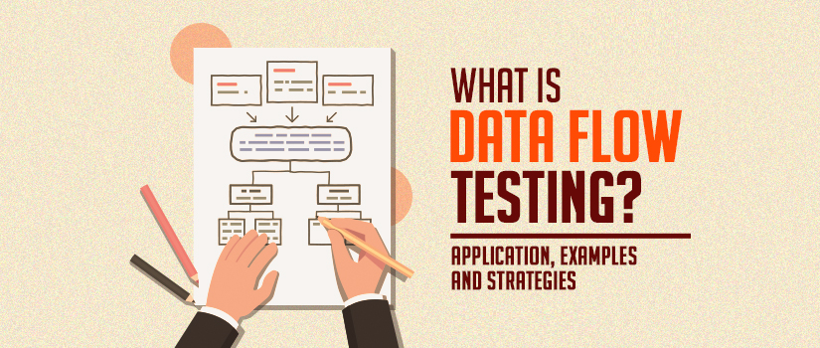

Slide 4
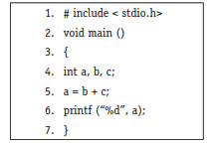
Data flow testing
In control flow testing, we find various paths of a program and design test cases to execute those paths.
We may like to execute every statement of the program at least once before the completion of testing.
Consider the following program:

Slide 5
Data flow testing
Data flow testing may help us to minimize such mistakes. It is done to cover the path testing and branch testing gap.
It has nothing to do with dataflow diagrams. It is based on variables, their usage and their definition(s) (assignment) in the program.
The main points of concern are:
Statements where these values are used (referenced).
Statements where variables receive values (definition).
Data flow testing focuses on variable definition and variable usage.
The process is conducted to detect the bugs because of the incorrect usage of data variables or data values.

Slide 6
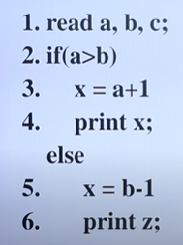
Example

Slide 7
Example
 | define | usage
A | 1 | 2,3
B | 1 | 2,5
C | 1 | NA
X | 3,5 | 4
Z | NA | 6
 | Define/usage
A | 1,2 1,3
B | 1,2 1,5
C | 1,NA
X | 3,4,5
Z | NA,6

Slide 8
Define/Reference Anomalies
Some of the define / reference anomalies are given as:
A variable is defined but never used / referenced.
A variable is used but never defined.
A variable is defined twice before it is used.
A variable is used before even first-definition.
Define / reference anomalies may be identified by static analysis of the program.

Slide 9
Data flow testing terms definitions
A program is first converted into a program graph.
Defining node: A node of a program graph is a defining node for a variable , if and only if, the value of the variable is defined in the statement corresponding to that node. It is represented as DEF (Ꝩ, n) where is the variable and n is the node corresponding to the statement in which is defined.
Usage node: A node of a program graph is a usage node for a variable , if and only if, the value of the variable is used in the statement corresponding to that node. It is represented as USE (Ꝩ, n), where ‘Ꝩ ’ is the variable and ‘n’ in the node corresponding to the statement in which ‘Ꝩ’ is used.
A usage node USE (Ꝩ, n) is a predicate use node (denoted as P-use), if and only if, the statement corresponding to node ‘n’ is a predicate statement otherwise USE (Ꝩ, n) is a computation use node (denoted as C-use).

Slide 10
Data flow testing terms definitions
Definition use Path:
A definition use path (denoted as du-path) for a variable ‘Ꝩ’ is a path between two nodes ‘m’ and ‘n’ where ‘m’ is the initial node in the path but the defining node for variable ‘Ꝩ ’ (denoted as DEF (Ꝩ, m)) and ‘n’ is the final node in the path but usage node for variable ‘Ꝩ ’ (denoted as USE (Ꝩ , n)).

Slide 11

Identification of du Paths
The various steps for the identification of du and dc paths are given as:
Draw the program graph of the program.
Find all variables of the program and prepare a table for define / use status of all variables using the following format:
Generate all du-paths from define/use variable table of above step by using following format”

Slide 12
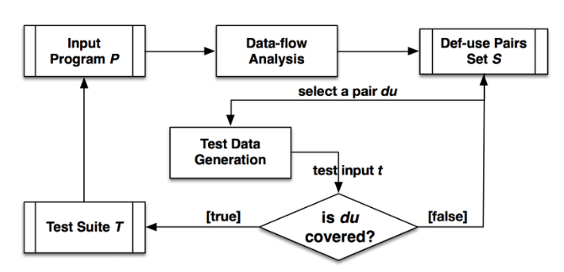
data flow testing cycle

Slide 13
Testing Strategies Using du-Paths
We want to generate test cases which trace every definition to each of its use and every use is traced to each of its definition. Some of the testing strategies are given as:
Test all du-paths
All du-paths generated for all variables are tested. This is the strongest data flow testing strategy covering all possible du-paths.
Test all uses
Find at least one path from every definition of every variable to every use of that variable which can be reached by that definition.
For every use of a variable, there is a path from the definition of that variable to the use of that variable.

Slide 14
Testing Strategies Using du-Paths
Test all definitions
Find paths from every definition of every variable to at least one use of that variable;
The first requires that each definition reaches all possible uses through all possible du-paths, the second requires that each definition reaches all possible uses, and the third requires that each definition reaches at least one use.

Slide 15
Types of Data Flow Testing
Static Data Flow Testing: No actual execution of the code is carried out in Static Data Flow testing. Generally, the definition, and usage pattern of the data variables is scrutinized through a control flow graph.
Dynamic Data Flow Testing: The code is executed to observe the transitional results. Dynamic data flow testing includes:
Identification of definition and usage of data variables.
Identifying viable paths between definition and usage pairs of data variables.
Designing & crafting test cases for these paths.

Slide 16
Data Flow Testing Limitations
Testers require good knowledge of programming.
Time-consuming
Costly process.

Slide 17
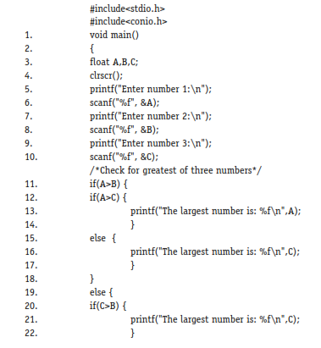
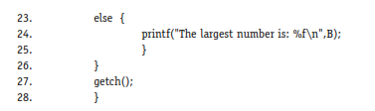
Example: find the largest number amongst three numbers.

Slide 18
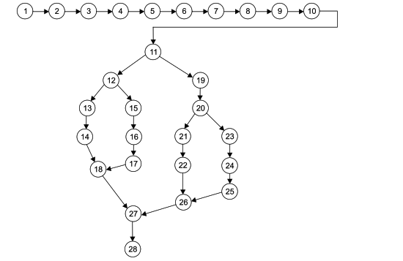
Step 1

Slide 19
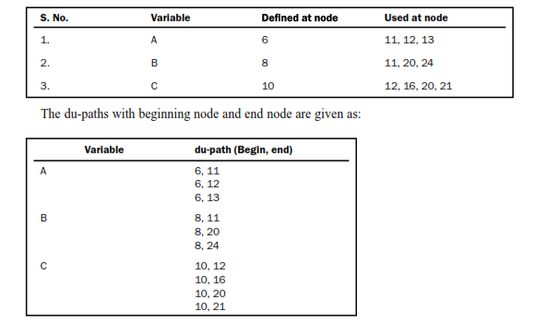
Step II & III

Slide 20
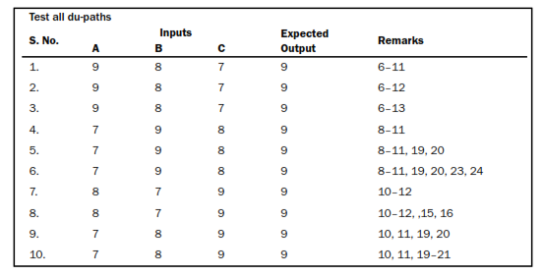
Test cases

